Slide 1
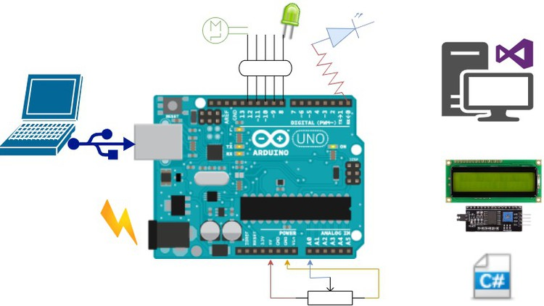
Introduction to Arduino Programming.

Slide 2
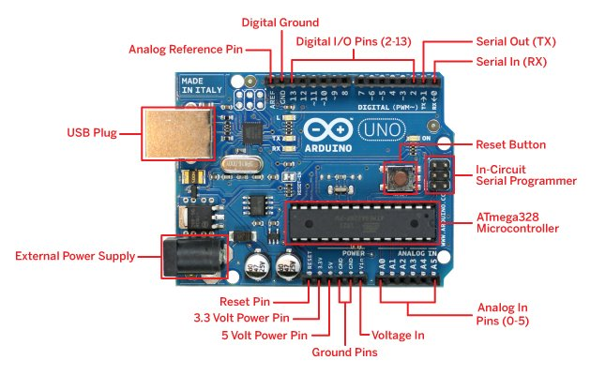
Introduction to Arduino
Arduino is an open-source electronics platform based on easy-to-use hardware and software. It's widely used by hobbyists, educators, and professionals for prototyping and creating interactive electronic projects.
Importance of Arduino in DIY Electronics: Arduino empowers users to bring their creative ideas to life through hands-on experimentation, making it a popular choice for DIY enthusiasts and makers.
Versatility and Flexibility of Arduino Platform: With a wide range of compatible sensors, actuators, and shields, Arduino offers limitless possibilities for building projects in areas such as home automation, robotics, IoT, and more.

Slide 3
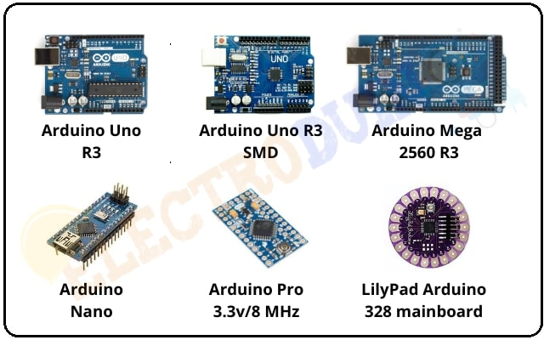
Arduino Overview
Various kinds of Arduino boards are available depending on different microcontrollers used. However, all Arduino boards have one thing in common: they are programed through the Arduino IDE.
The differences are based on the number of inputs and outputs (the number of sensors, LEDs, and buttons you can use on a single board), speed, operating voltage, form factor etc. Some boards are designed to be embedded and have no programming interface (hardware), which you would need to buy separately. Some can run directly from a 3.7V battery, others need at least 5V.

Slide 4
Arduino Board Description
Types of Arduino Boards: Arduino offers a range of boards catering to different needs, including Uno, Mega, Nano, and more specialized variants like the Lilypad and Arduino Due.
Key Components and Features of Arduino Boards: Arduino boards typically consist of a microcontroller, digital and analog I/O pins, power supply options, and onboard peripherals like LEDs and buttons.
Selection Criteria for Choosing the Right Arduino Board: Factors such as project requirements, size constraints, available I/O pins, processing power, and budget influence the choice of the appropriate Arduino board.

Slide 5
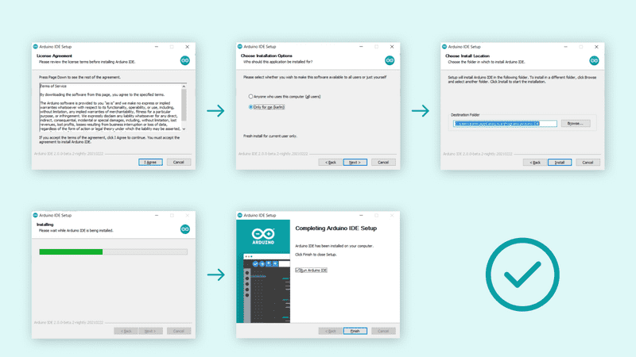
Arduino Installation
Step-by-Step Guide for Installing Arduino IDE: Installing the Arduino IDE involves downloading the software from the official website and following simple installation instructions tailored to your operating system.
Configuring IDE for Different Operating Systems: Arduino IDE is compatible with Windows, macOS, and Linux, and configuration steps may vary slightly depending on the platform.
Troubleshooting Installation Issues: Common installation problems such as driver issues, communication errors, and permission settings can be resolved by following troubleshooting guides provided by the Arduino community.

Slide 6
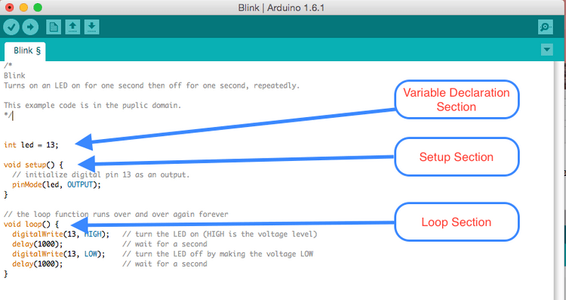
Arduino Program Structure
Anatomy of an Arduino Sketch: Arduino programs, known as sketches, consist of two main functions: setup() and loop(). The setup() function is executed once at the beginning, while the loop() function runs continuously.
Setup() and Loop() Functions: The setup() function is used for initializing variables, configuring pins, and setting initial conditions, while the loop() function is where the main program logic resides, executing repeatedly until the board is powered off.
Basic Syntax and Conventions: Arduino sketches follow a simplified syntax based on C/C++, making it accessible even to beginners. Consistent indentation and commenting practices enhance code readability and maintainability.

Slide 7
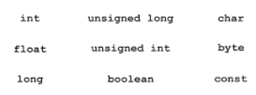
Arduino Data Types
Fundamental Data Types: Arduino supports various data types such as int, float, char, Boolean, etc., each with its own size and range.
Size and Range of Data Types: Understanding the size and range of data types is crucial for efficient memory usage and preventing overflow or truncation errors in Arduino programs.
Importance of Choosing the Right Data Type: Selecting the appropriate data type based on the nature and range of values involved in a variable ensures optimal performance and resource utilization in Arduino projects.

Slide 8
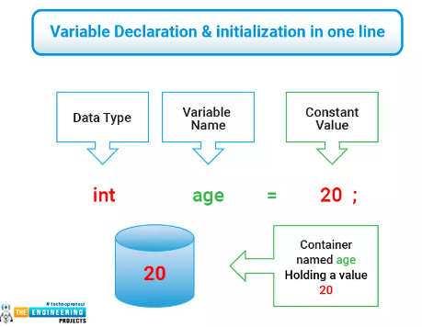
Arduino Variables & Constants
Declaring and Initializing Variables: Variables in Arduino are declared using a specific data type and can be initialized with an initial value. They hold data that may change during the execution of a program.
Scope and Lifetime of Variables: Variables can have local or global scope, affecting their accessibility within different parts of the program. Their lifetime depends on where they are declared and their scope.
Constants and their Usage in Arduino Sketches: Constants are variables whose values cannot be altered during program execution. They are useful for defining parameters, pin mappings, and other fixed values in Arduino sketches.

Slide 9
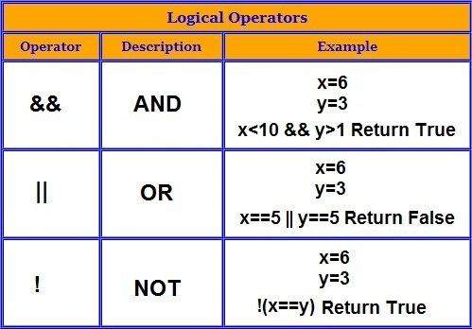
Arduino Operators
Arithmetic, Comparison, Logical, and Bitwise Operators: Arduino supports a variety of operators for performing mathematical calculations, comparisons, logical operations, and bit manipulations.
Precedence and Associativity of Operators: Operators in Arduino follow a specific order of precedence and associativity, which determines the sequence in which they are evaluated in an expression.
Examples of Operator Usage in Arduino: Understanding how to use operators efficiently is essential for performing complex calculations, controlling program flow, and manipulating data in Arduino sketches.

Slide 10
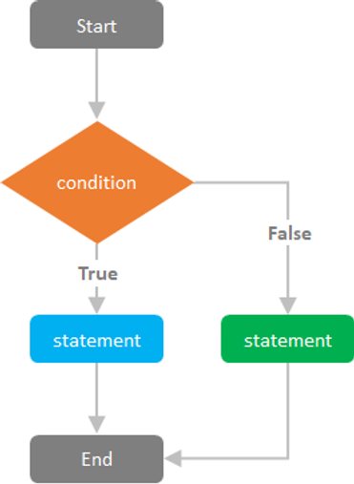
Arduino Control Statements
Conditional Statements (if, else, switch): Conditional statements in Arduino allow the program to make decisions based on certain conditions. They control the flow of execution by selectively executing different blocks of code.
Control Flow in Arduino Sketches: Control flow refers to the order in which statements are executed in an Arduino program. It can be linear or branched, depending on the presence of control statements like loops and conditionals.
Example Applications of Control Statements: Control statements are used extensively in Arduino sketches for tasks such as sensor readings, motor control, decision-making logic, and user interaction.

Slide 11
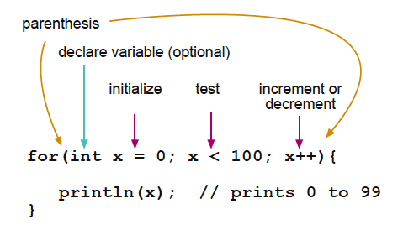
Arduino Loops
Types of Loops (for, while, do-while): Loops are used in Arduino sketches to execute a block of code repeatedly. Arduino supports different types of loops, including for, while, and do-while loops, each with its own syntax and usage.
Iteration and Looping Constructs in Arduino: Loops enable iterative operations such as reading sensor data, controlling actuators, and processing input/output asynchronously. They play a crucial role in implementing repetitive tasks efficiently.
Best Practices for Using Loops in Arduino Sketches: Optimizing loop performance, avoiding blocking code, and handling loop exit conditions are key considerations when designing Arduino sketches to ensure responsiveness and reliability.

Slide 12
Reference Links
https://www.arduino.cc/en/Tutorial/HomePage
https://online.flippingbook.com/view/705248699/18/
https://www.tutorialspoint.com/arduino/index.htm
https://www.javatpoint.com/arduino-coding-basics

Slide 13
Thank You..

